Slide 1
Investigation of two CFD validation test cases for turbulent mixing of different gaseous species (fuel and oxidizer) in typical laboratory flame configurations
Student : Malav M Soni
Supervisor : Dr. Thorsten Möller
Date : 12/10/2015

Slide 2
Content
Objectives of present work
Turbulence and its theory
Turbulence models (RANS) used for investigation
Test case I (Sandia National Laboratory Propane Jet)
Experimental Data
Computational Domain
Quality Criteria
Conclusion
Test case II (Sydney Bluff Body Jet)
Experimental Data
Computational Domain
Quality Criteria
Conclusion

Slide 3
Objectives of the present work
Combustion
Turbulence
Thermo-chemistry coupled with fluid mechanics, interaction of non-linear processes
Reacting flow i.e. jet flame
Very complicated, limited range
Modelling of flows
Non-reacting flow
Turbulence is separated from the complex combustion chemistry

Slide 4
Objectives of the present work
Aim :
To study and investigate the flow structure and the turbulent mixing behind the bluff body, in the absence of complex combustion chemistry and heat release i.e. isothermal, with different RANS models
ANSYS CFX 16.1 and ANSYS Fluent 17.0
This study is divided in to parts:
Part I : Investigation of the Sandia National Laboratory Propane Jet (quasi-2d)
Part II : Investigation of Sydney Bluff Body Jet Flame (full 3d)

Slide 5
Turbulence and its theory
What is turbulence ?
Navier stokes equation can be used to describe both laminar and turbulent flows without the need for additional information
Alternative :
Mathematical model which accounts for the effects of turbulence without being computationally expensive
Turbulence can be described as:
Reynolds Number
Non-linear process
Rotational flow structures
Phenomenon
Disadvantage : Computationally expensive

Slide 6
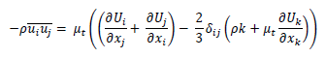
Turbulence and its theory
Time Averaging
DNS
LES
RANS
Reynolds stress model (RSM)
Algebraic RSM
Differential RSM
Eddy Viscosity model
(EVM)
Zero equation model
One equation model
Two equation model
Boussinesq Approximation
Individual equations solved for all the components of Reynolds stresses

Slide 7
Turbulence models used for Investigation
 | Turbulence model | Specification
Two equation model | K-ω | Two additional equation (K & ω)
 | K-ω SST | Blending function used to switch between K-ω & Standard K-ԑ
 | Standard K-ԑ | Two additional equation (K & ԑ)
 | Realizable k-ԑ | Two additional equation (K & ԑ) with ԑ equation modified
Reynolds stress model | BSL RSM | ω based RSM + Base line RSM
 | EARSM | Algebraic RSM based on extension of K-ԑ and BSL

Slide 8
Part I – Sandia National Laboratory Propane Jet
Experimental Reference
Robert W. Schefer “Data Base for a Turbulent, Non-premixed, Non-reacting Propane-Jet Flow “, Sandia National Laboratories Research Report, 1985, pp. 1-21.
R.W.Schefer and R.W.Dibble,”Mixture Fraction Field in a Turbulent Non-reacting Propane Jet”, AIAA Journal, Vol.39, no.1, pp.64-72, 2001
Measuring Instrument | Quantities measured
Laser Doppler Anemometer (LDA) | Velocity & turbulence parameters
Rayleigh Scattering | Mixture fraction

Slide 9
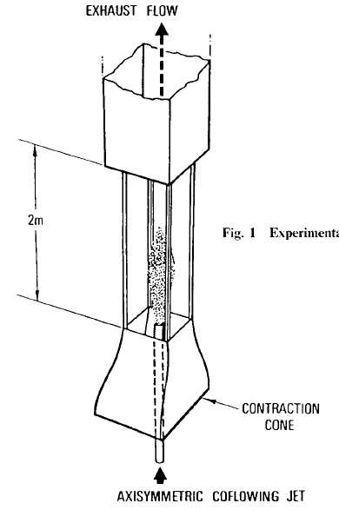
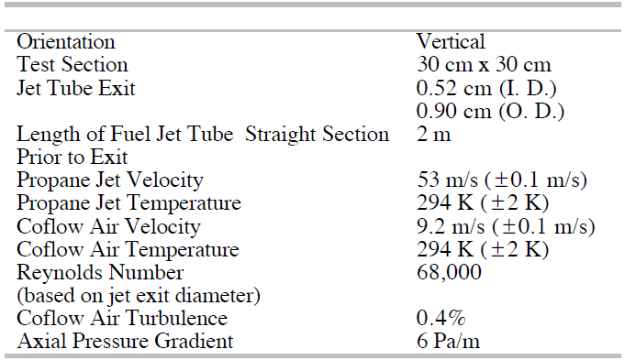
Test case description (Experimental Setup)
Dimension of the test setup
AXISYMMETRIC FUEL JET

Slide 10
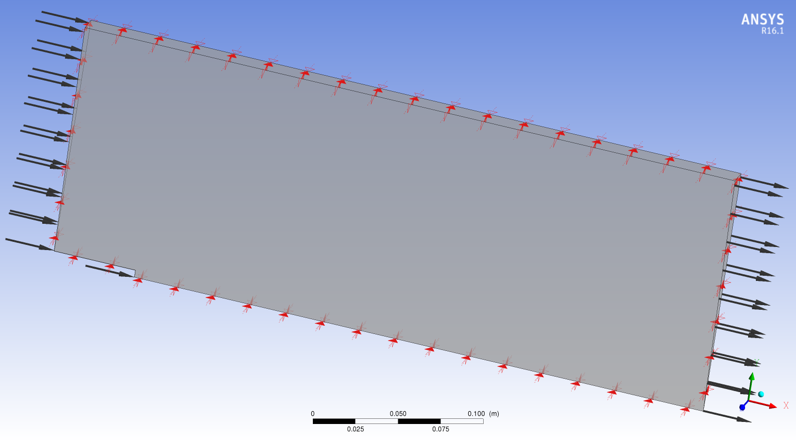
Computational Domain
No Slip Wall
Outer wall
Co-Flow Air Inlet
Monitoring Points
Pressure Outlet
Propane Jet Inlet
No Slip Wall
Front & back surfaces of the Comp. Domain are Symmetry planes

Slide 11
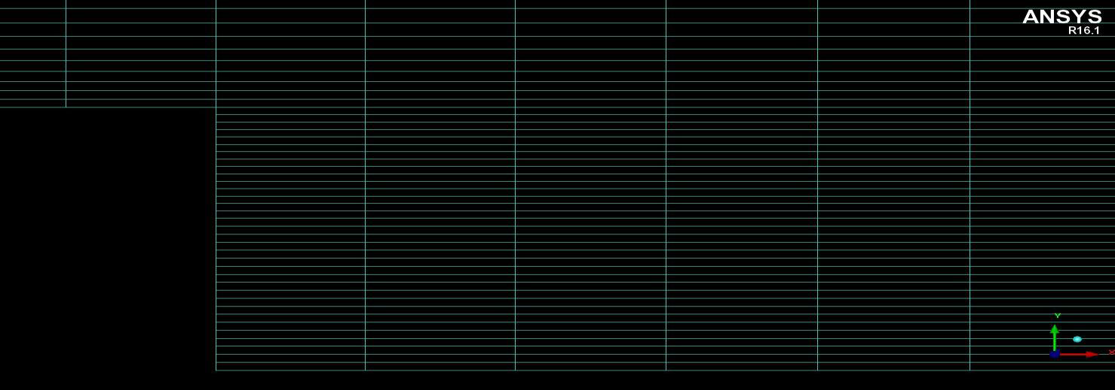
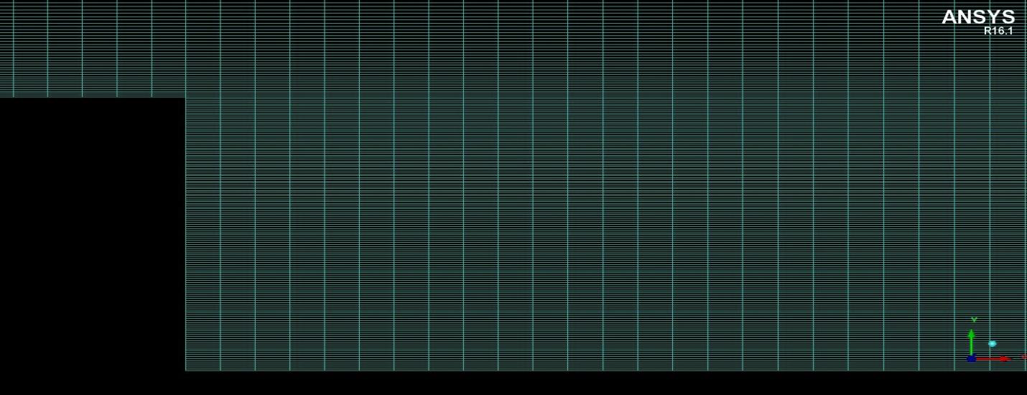
Computational Mesh
Parameter | Mesh 1 | Mesh 2 | Mesh 3 | Mesh 4
Type of Mesh | Hexahedral | Hexahedral | Hexahedral | Hexahedral
Number of Nodes | 3736 | 15568 | 63532 | 256660
Number of Elements | 7665 | 31530 | 127860 | 514920
Max Aspect Ratio | 22.57 | 24.54 | 25.59 | 26.52
Min Angle | 90° | 90° | 90° | 90°
Mesh 2
Mesh 4

Slide 12
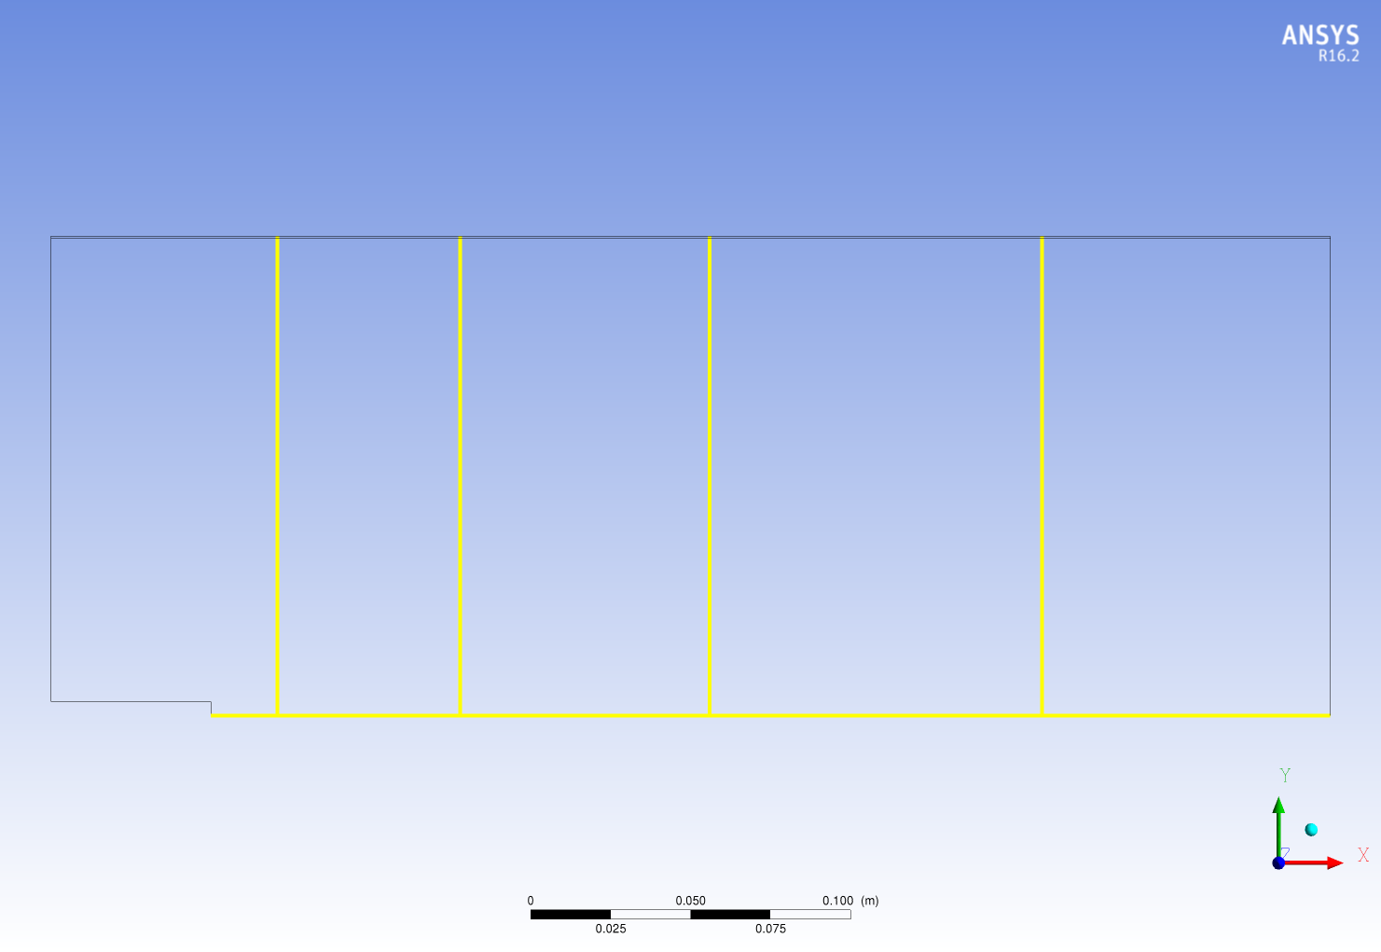
Measured Quantities and Measurement locations
Mean radial and axial velocity component (U, V)
Mean mixture fraction
X/D = 4
X/D = 15
X/D = 30
X/D = 50
Y/D = 0

Slide 13
Boundary Condition
Surface Name | Boundary condition for ANSYS CFX 16.1 | Boundary condition for ANSYS Fluent 17.0
Co-flow inlet | Normal Velocity = 9.2 [m/s] Turbulent Intensity = 0.5% Turbulent viscosity ratio = 10 | Normal Velocity = 9.2 [m/s] Turbulent Intensity = 0.5% Turbulent viscosity ratio = 10
Fuel jet inlet | u, v, w, k, ԑ and ω interpolated from the imported fully developed pipe flow profile | u, v, w, k, ԑ and ω interpolated from the imported fully developed pipe flow profile
Outlet | Average static pressure Relative pressure = 0 [Pa] Pressure profile blend = 0.05 | Average static pressure Gauge pressure = 0 [Pa] Pressure profile blend = 0.05
Bluff body | No slip wall | No slip wall
Outer wall | Free slip wall | Free slip wall
Symmetry 1 & 2 | Symmetry | Symmetry

Slide 14
Quality Assurance
The following investigations have been carried out in order to assure the quality of the CFD simulation:
Iteration error
dependence of CFD solution on the strength of the applied convergence criterion
Spatial Discretization error
grid independence of the CFD solution
Turbulent inlet boundary condition study
Turbulent Schmidt number (Sc_{t}) study
different Sc_{t} ranging from 0.6 – 0.9 are used to study with which Sc_{t} the result with best accuracy is delivered
Model error
comparison of SST, k-ω, k-ԑ, BSL RSM and EARSM turbulence models

Slide 15
Quality Assurance
The following investigations have been carried out in order to assure the quality of the CFD simulation:
Iteration error
dependence of CFD solution on the strength of the applied convergence criterion
Spatial Discretization error
grid independence of the CFD solution
Turbulent inlet boundary condition study
Turbulent Schmidt number (Sc_{t}) study
different Sc_{t} ranging from 0.6 – 0.9 are used to study with which Sc_{t} the result with best accuracy is delivered
Model error
comparison of SST, k-ω, k-ԑ, BSL RSM and EARSM turbulence models

Slide 16
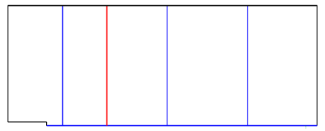
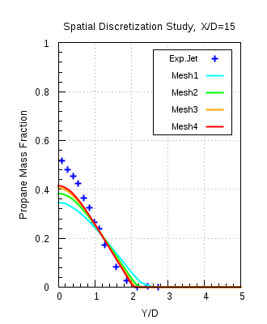
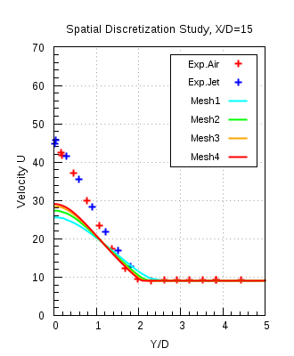
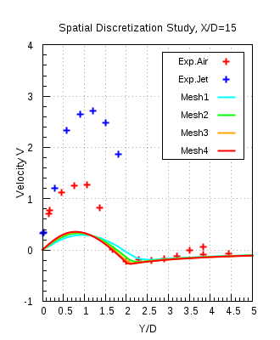
Spatial Discretisation Study (Mesh independency)
ANSYS CFX 16.1,
K-ω SST
Mesh 4 is chosen for further investigations

Slide 17
Test of turbulent Inlet Boundary Conditions (TIBC), Mesh 4
Test to check the appropriate TIBC
Turbulent kinetic energy (k) and length scale (LS) used
Round jet anomaly phenomenon
K-ω SST and Standard K-ԑ models are used in combination with different TIBC`s
Propane mass fraction , velocity profiles compared with each other as well as with the experimental data

Slide 18
Test of Turbulence Inlet Boundary Condition (TIBC)
Test Name | Turbulence Model | Turbulence Boundary Condition Fuel Inlet | Turbulence Boundary Condition Air Inlet
CSV_SST | SST | K and ω | Fractional Intensity & Eddy Viscosity ratio
CSV_KEpsilon# | K-ε | K and ε | Fractional Intensity & Eddy Viscosity ratio
KLS_SST | SST | K and LS | K and LS
KLS_KEpsilon# | K-ε | K and LS | K and LS
Propane_Air_Inlet_ CSV**(PA CSV SST) | SST | K and ω | Fractional Intensity* & Eddy Viscosity ratio
Round Jet Anomaly : The standard k-ε model with the standard coefficients delivers the velocity field quite accurately in two-dimensional plane jet, but large errors occur for the axisymmetric jets. Specifically, the spreading rate of round jet is overestimated by 40% [Ref. Pope].
Reason : Modeling of dissipation (ε) equation

Slide 19
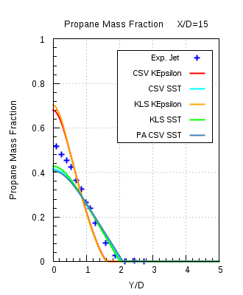
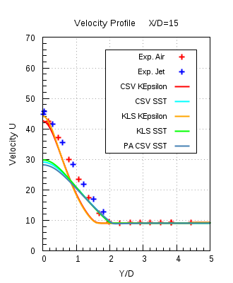
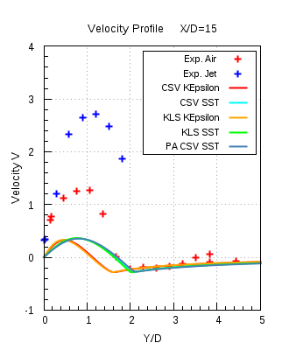
TIBC – Results comparison
ANSYS CFX 16.1

Slide 20
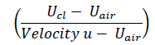
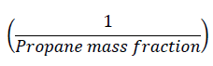
TIBC – Results comparison
For the purpose of comparison, two new non-dimensionalised quantities were introduced to compare the velocity and the mass fraction decay along the axial direction.
Velocity u invariant (U invar)
where, U_{cl} is the centerline velocity, U_{air} is the constant velocity of co-flow air 9.2 m/s,
Velocity u is the result obtained from the numerical calculation.
Propane mass fraction invariant (PMF invar)

Slide 21
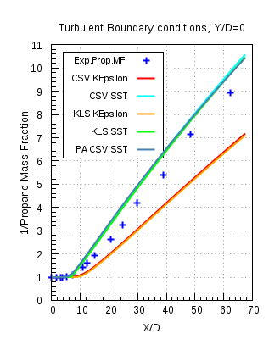
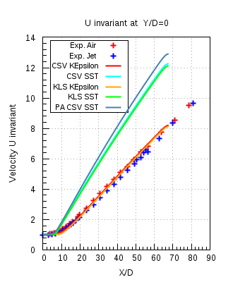
TIBC – Results comparison
ANSYS CFX 16.1

Slide 22
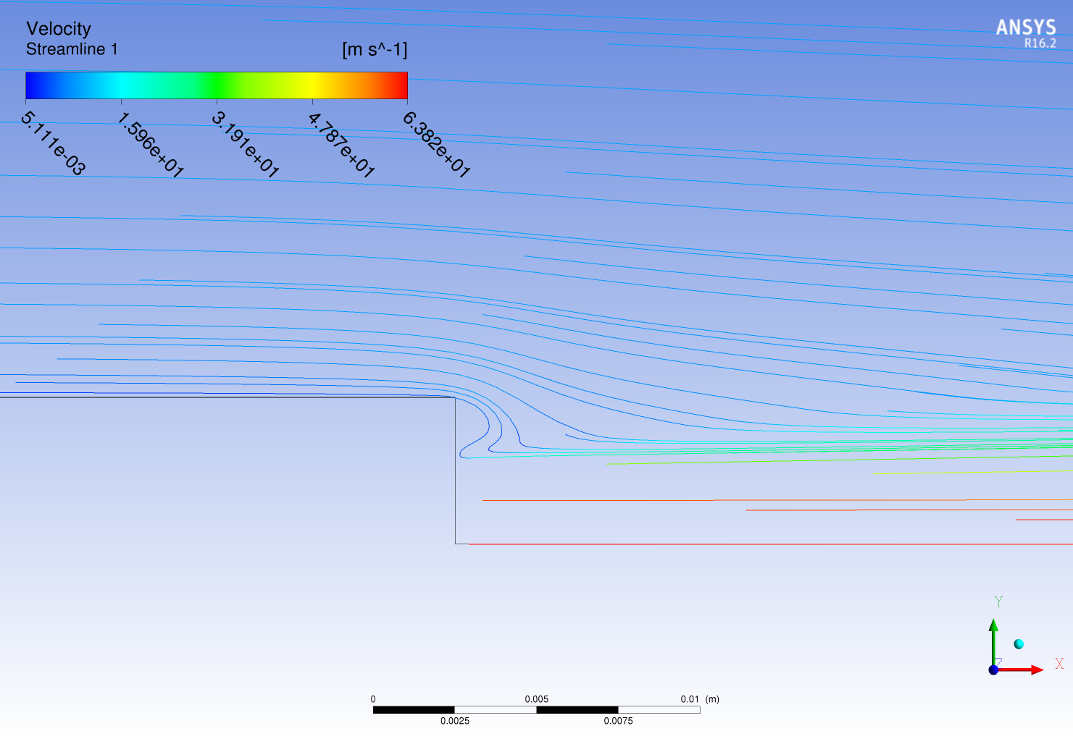
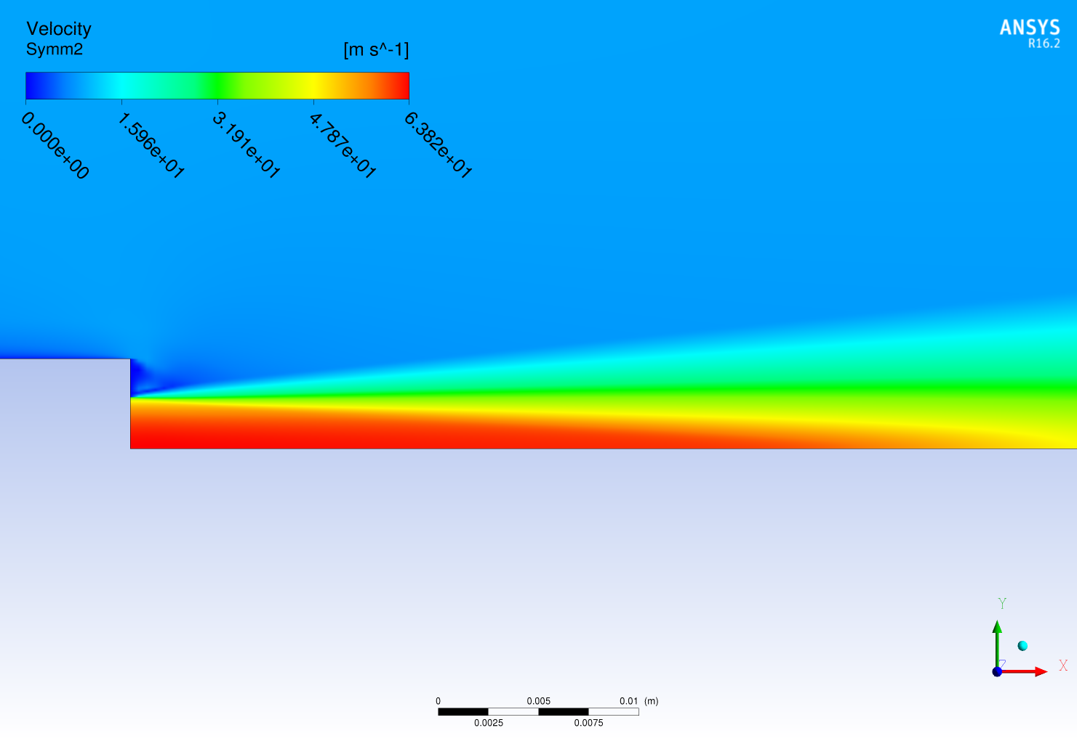
TIBC – Results
PA CSV SST

Slide 23
Model Error Study, Mesh 4
For this study the following turbulent models are used :
K-ω SST
K-ε
K-ε modified
BSL RSM (Base line reynolds stress model)
EARSM (Explicit algebraic reynolds number)
Resulting profiles for the propane mass fraction and velocities are compared with the other turbulence models and the experimental data

Slide 24
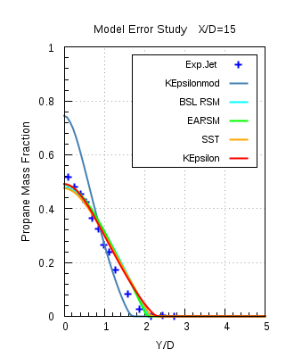
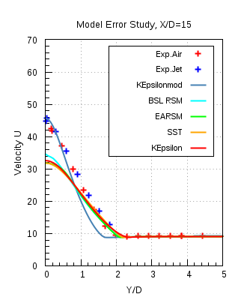
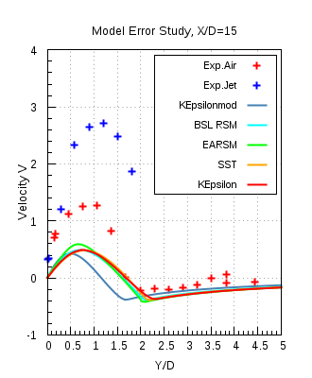
Model Error - Results
ANSYS CFX 16.1

Slide 25
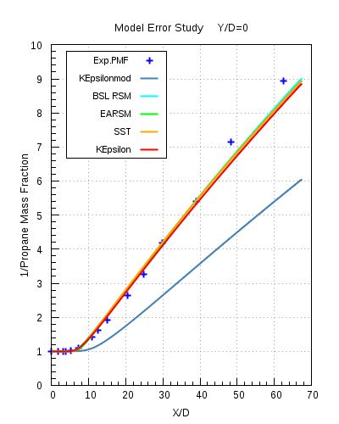
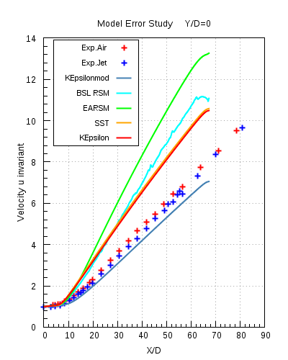
Model Error- Results
ANSYS CFX 16.1

Slide 26
Solver Comparison between ANSYS CFX 16.1 and ANSYS Fluent 17.0, Mesh 4
The following two turbulence models are used for the solver comparison
K-ω SST
K-ε

Slide 27
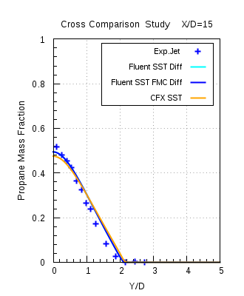
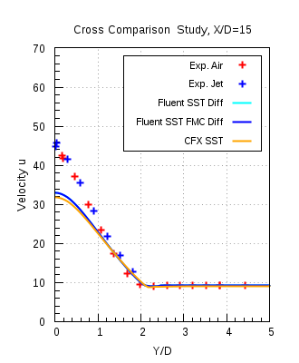
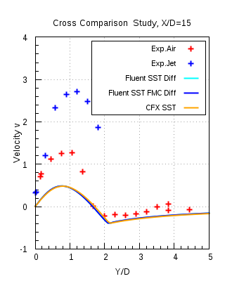
Solver Comparison
ANSYS CFX 16.1 and ANSYS Fluent 17.0
k-ω SST

Slide 28
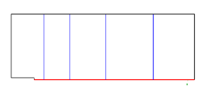
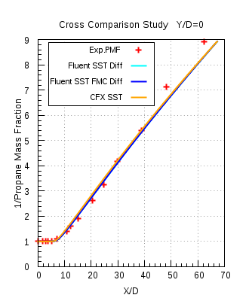
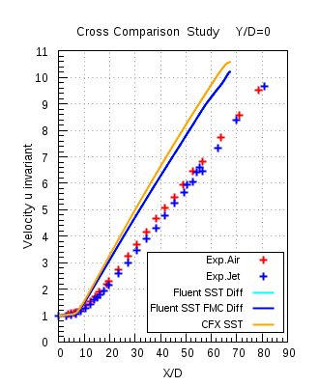
Solver Comparison
ANSYS CFX 16.1 and ANSYS Fluent 17.0,
k-ω SST

Slide 29
Conclusion
In this test case the investigation of the turbulent mixing of species in the recirculation zone behind the bluff body was carried out with isothermal and steady state flow conditions
K-ω SST model would be the recommended turbulence model. Both k-ε models give almost the same level of accuracy in this investigation, but with more difficulties in obtaining a converged solution
Differences observed in the axial velocity profiles is due to the simplifying assumptions made in the RANS turbulence models and also due to the round jet anomaly
Modification in the model constants is not suggested
improves comparison of velocity profiles
but at the price of deteriorated Propane mass fraction profiles
Turbulent Schmidt number (Sc_{t}) for the transport equation of species should be 0.9
If desired, higher accuracy results can be obtained with e.g. Large Eddy Simulation (LES) or hybrid models, but at much higher computational costs

Slide 30
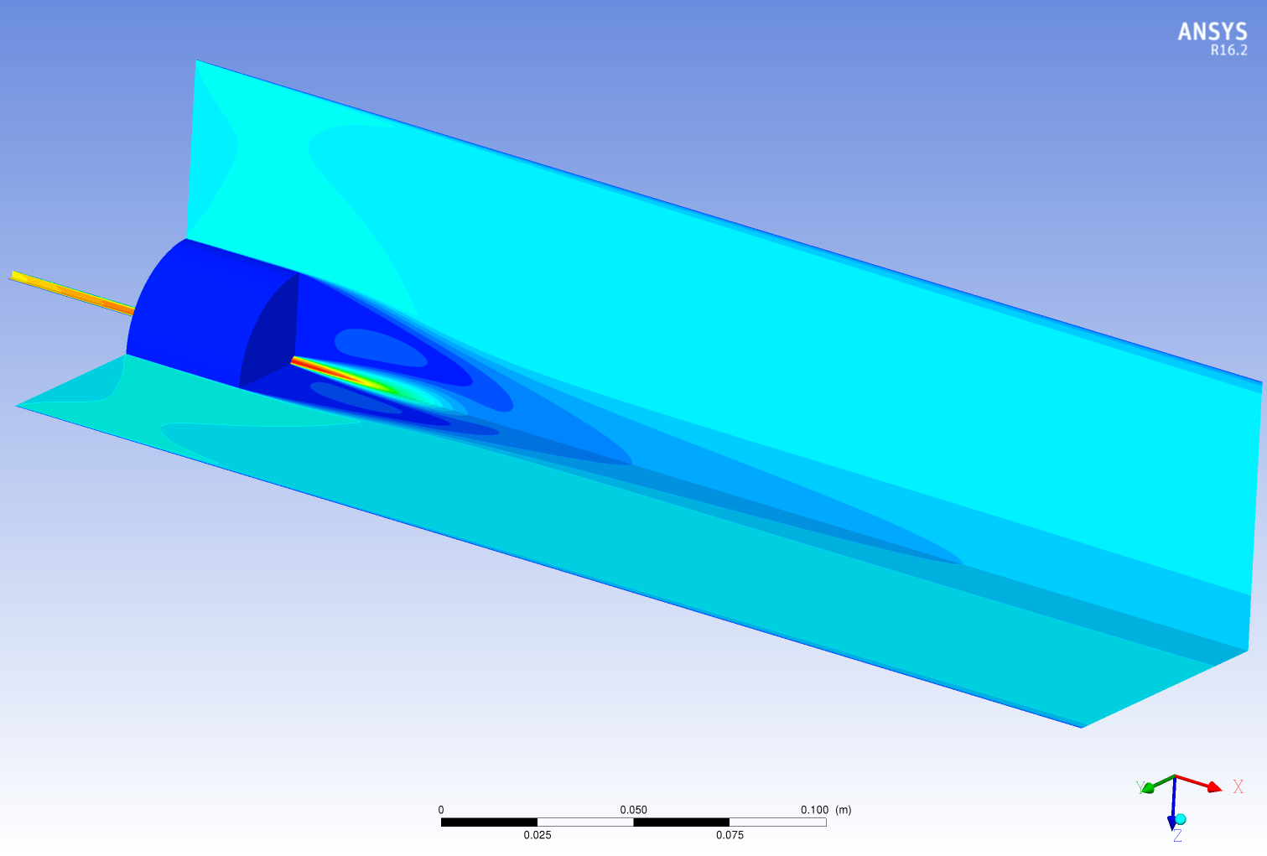
Part II - Sydney Bluff Body Jet

Slide 31
Experimental References
Main Reference:
The University of Sydney, Department of Mechanical and Mechatronic Engineering and Sandia National Laboratories Combustion Research Facility, “Turbulent Non premixed Combustion Data for Piloted and Bluff-Body Stabilized Flows”
http://sydney.edu.au/engineering/aeromech/thermofluids/bluff.htm
Secondary Reference:
Dally, Bassam B., Masri, Assaad R., Fletcher, David F. “Modeling of bluff body recirculating flows”, Twelfth Australasian Fluid Mechanics Conference, The University of Sydney, Australia, pp. 529-532, 1995
B.B.Dally, D F Fletcher & A.R.Masri, “Flow and mixing fields of turbulent bluff-body jets and flames”, Combustion Theory and Modeling 2, pp.193-219, 1998

Slide 32
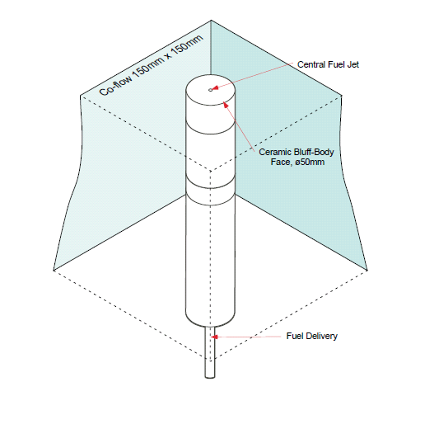
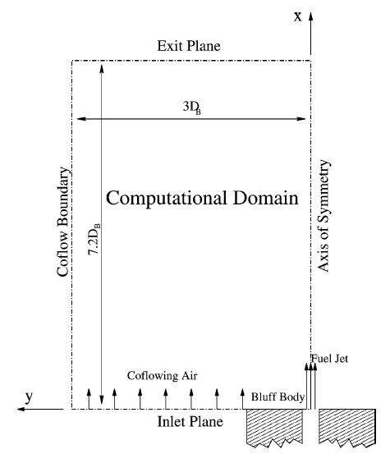
Experimental Setup
1.5D_{b}
6.08D_{b}
Fig (a) Sydney bluff body burner placed in the wind tunnel
Fig (b) 2D axis-symmetric experimental setup

Slide 33
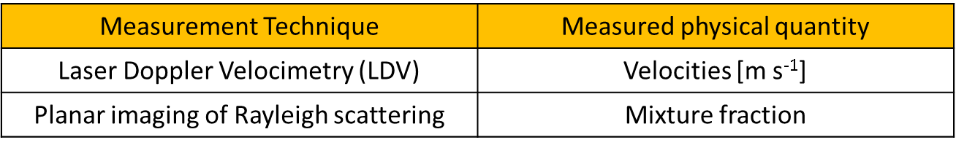
Experimental data
Experiment has been performed in two parts
Constant density flow : Velocity profiles were measured
Variable density flow : Mixture fraction profiles were measured
Air velocity in co-flow is 20 [m s⁻¹ ] in all cases
For fuel different velocities are being considered for different fuels:
Air : 61 [m s⁻¹]
CNG : 50, 85, 143 [m s⁻¹]
Ethylene : 50, 63, 80 [m s⁻¹]
LPG : 50, 70 [m s⁻¹]
Temperature T_{inlet} : 298 [k]

Slide 34
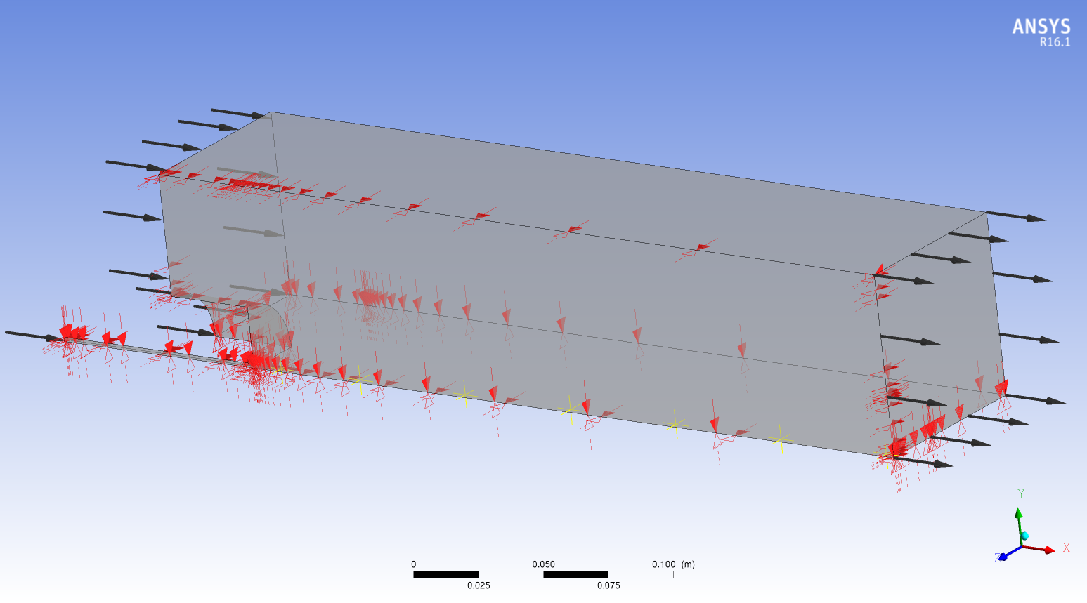
Computational Domain
Co-flow inlet
Top and back Wall 1 & 2
Pressure Outlet
Fuel inlet
Front and bottom Symmetry 1 & 2

Slide 35
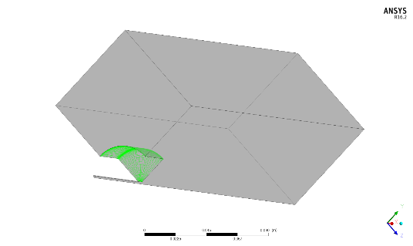
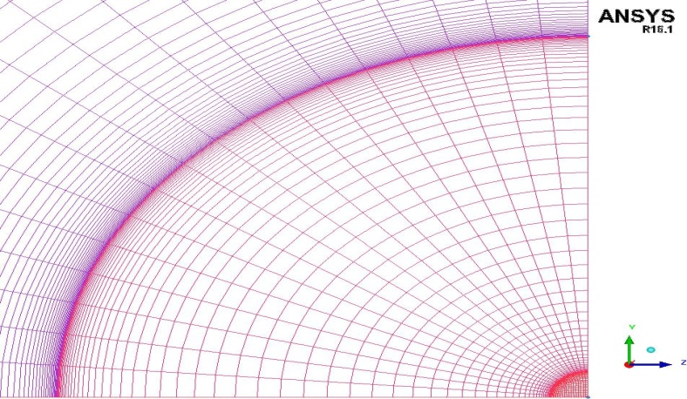
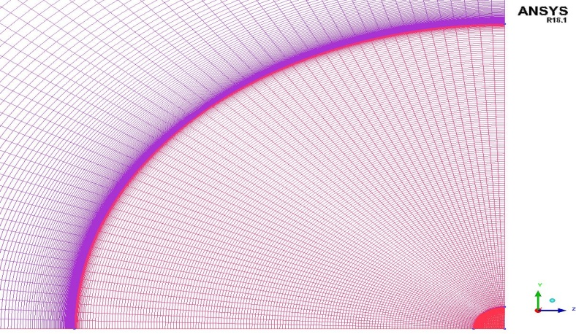
Computational Domain & Meshes
 | Mesh 1 | Mesh 2 | Mesh 3
Elements | 445779 | 3649862 | 12367909
Nodes | 477248 | 3773055 | 12648672
Max. Aspect Ratio | 665 | 1864 | 3046
Min. Grid Angle | 45° | 44.19° | 40.95°
Mesh 1
Mesh 3

Slide 36
Boundary Conditions (Variable density)
Name | ANSYS CFX 16.1 | ANSYS Fluent 17.0
Co-flow inlet | Normal Velocity = 20 [m/s] Turbulent Intensity = 2 % Turbulent viscosity ratio = 10 | Normal velocity = 20 [m/s] Turbulent Intensity = 2 % Turbulent viscosity ratio = 10
Fuel Inlet | Normal Velocity = 50* [m/s] Turbulent Intensity = 5 % Turbulent viscosity ratio = 10 | Normal Velocity = 50* [m/s] Turbulent Intensity = 5 % Turbulent viscosity ratio = 10
Outlet | Average static pressure Relative pressure = 0 [Pa] Pressure profile blend = 0.05 | Average static pressure Gauge pressure = 0 [Pa] Pressure profile blend = 0.05
Bluff body | No Slip wall | No Slip wall
Wall 1 & 2 | No Slip wall | No Slip wall
Symmetry 1 & 2 | Symmetry | Symmetry
*Note: The velocities at jet inlet will depend on the experiments performed as mentioned in the literature

Slide 37
ANSYS CFX 16.1 Model Error, Mesh 2
Comparison of the mixture fraction profiles with the experimental data.
The following turbulence models:
K-ω SST
k-ε
The results showed are computed with fuel CNG

Slide 38
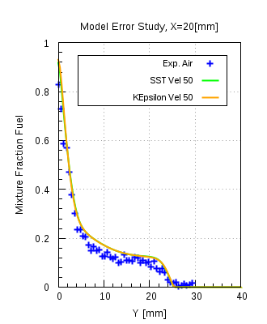
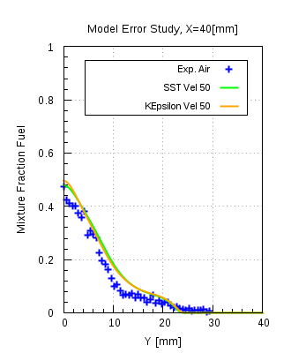
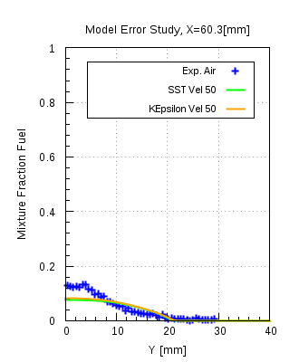
Model Error
CNG, Jet velocity = 50 m/s

Slide 39
ANSYS Fluent 17.0 Model Error, Mesh 2
Comparison of the mixture fraction profiles with the experimental data.
The following turbulence models:
k-ω SST
standard k-ε
realizable k-ε
The results showed are computed with fuel CNG

Slide 40
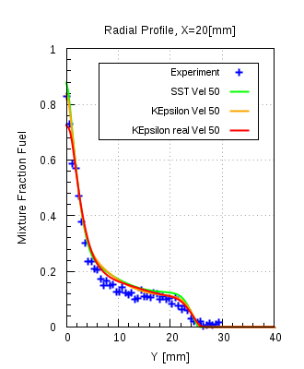
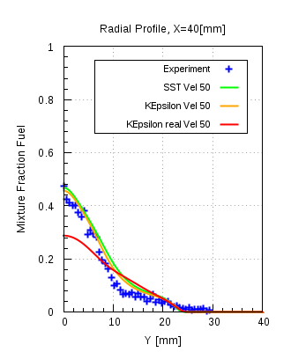
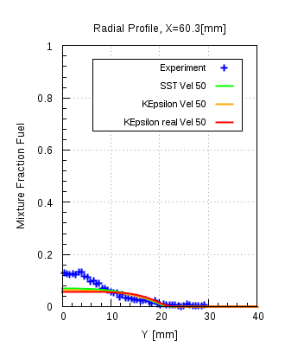
Model Error
CNG, Jet velocity = 50 m/s

Slide 41
Solver Comparison between ANSYS CFX 16.1 and ANSYS Fluent 17.0, Mesh 2
The following turbulence models are used for the solver comparison
k-ω SST
standard k-ε
realizable k-ε
The results shown here are computed with fuel CNG with Jet velocity 50 m/s, with standard k-ε and realizable k-ε model

Slide 42
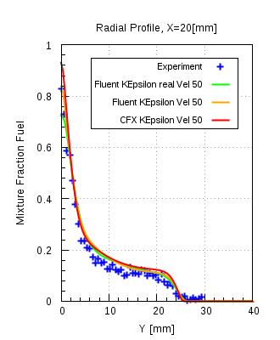
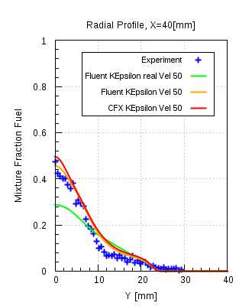
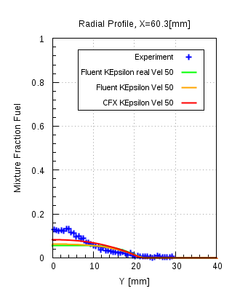
Solver Comparison
ANSYS CFX 16.1 and ANSYS Fluent 17.0,
CNG

Slide 43
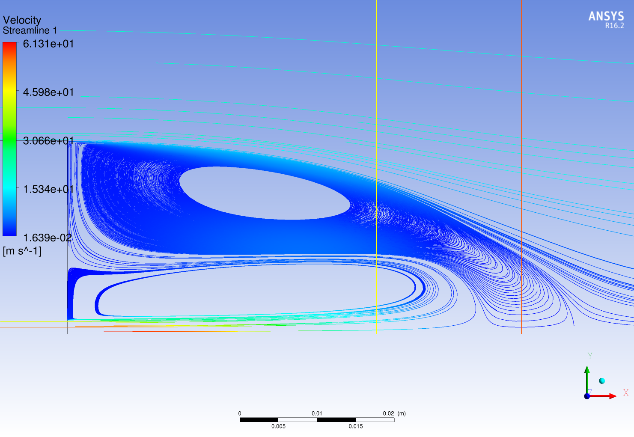
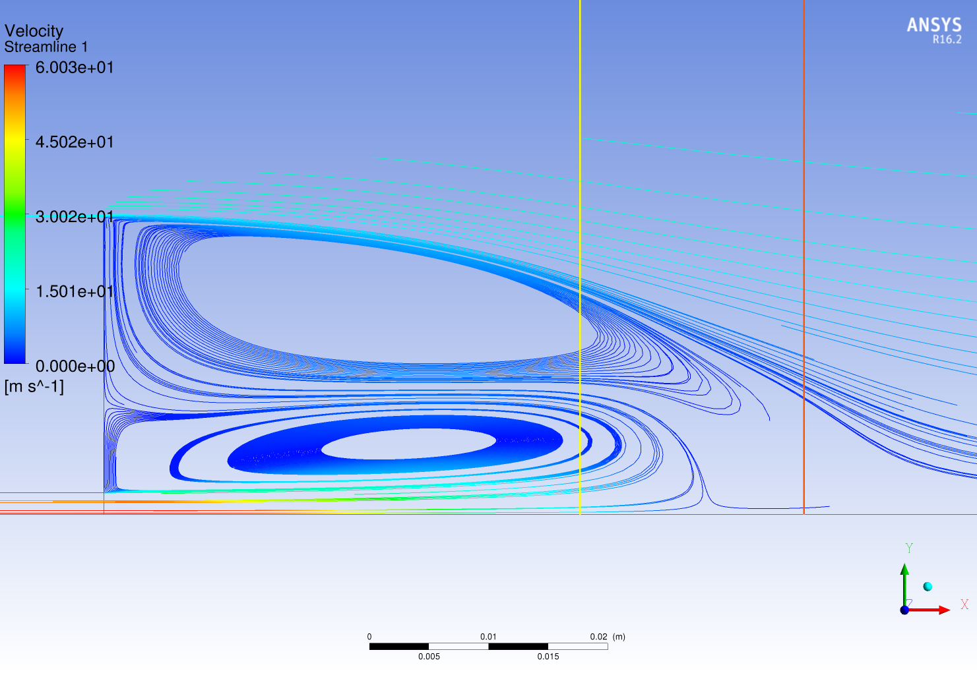

Solver Comparison
ANSYS CFX, K-ε, CNG, jet velocity = 50 [m s⁻¹]
ANSYS Fluent, K-ε
ANSYS Fluent, K-ε realizable

Slide 44




Solver Comparison
ANSYS CFX, K-ε, CNG, jet velocity = 50 [m s⁻¹]
ANSYS Fluent, K-ε
ANSYS Fluent, K-ε realizable

Slide 45
Conclusion
Two fully developed vortices are present in the recirculation zone
k-ω SST and standard k-ε model are the recommended turbulence models for the case of non-reacting turbulence mixing of the species
Realizable k-ε model over-predicts the mixing at certain locations in the downstream direction, specifically in case of CNG it is more prominent
Apart from that for all investigated cases the solutions of ANSYS CFX 16.1 and ANSYS Fluent 17.0 are in fairly good agreement with each other, as well as with the experimental data
Also, a comparison of the size of the recirculation zone, behind the bluff body, obtained from numerical results and experiment showed that they are of similar size (~ 50 [mm] as mentioned in the secondary reference)

Slide 46
Thank you for your attention!

Slide 48
ANSYS Fluent 17.0, Mesh 4

Slide 49
Material Properties
Precursor simulation uses gaseous Propane (C₃H₈)
A mixture was made using air and propane
Mixture Name | Composition
Mixture (Air and propane) | N₂ (75.52 %)
 | O₂ (23.15%)
 | Ar (1.28%)
 | CO₂ (0.0035%)
 | C₃H₈
Air
Propane

Slide 50
Model Error - Diffusivities
The following two diffusivities were compared with each other:
Constant kinematic diffusivity(CD) – Fixed Value provided
Full multi-component diffusivity (FD) – Kinetic theory of gases
With CD the kinematic diffusion coefficient was defined the same as it was used with ANSYS CFX
In the comparison plots the following naming convention has been used for the combination of the models with the different diffusivity models:
Diffusivity | SST | K-ε standard
Constant Diffusivity (CD) | SST Diff | KEpsilon Diff
Full multi-comp diffusivity (FD) | SST FMC Diff | KEpsilon FMC Diff

Slide 51


Model Error - Results

Slide 52


Model Error – Residuals and Imbalance monitors
Iteration steps:
141
141

Slide 53
Material Properties (Variable Density)
Three mixtures have been used in order to study the turbulent mixing of the co-flow air and the fuel jet:
Mixture Air: Fixed composition mixture
Mixture Fuel : Fixed composition mixture
Three different fuels have been used here for investigating the turbulent mixing with the co-flow air
Air fuel mixture: Variable composition mixture
Mixture Air and Fuel (depending on the fuel chosen) are defined as the variable composition mixture, with mixture air defined as the constraint
* Note: Composition for the mixtures have been used as per mentioned in the literature

